Slide 1
Asteroid Hub
Yusuf Shaik

Slide 2

Purpose
Challenge: Hey! What are you looking at?
Browse orbital diagrams of asteroids that could potentially impact earth
SMS subscription service for hazardous asteroids

Slide 3
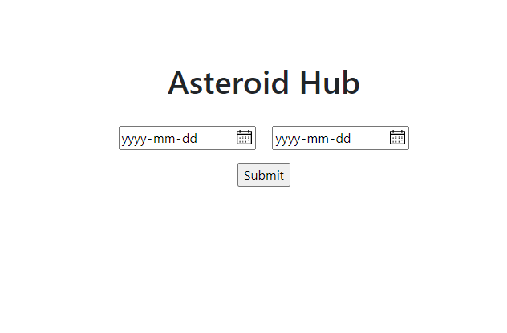
Initial Screen
Date search by asteroid’s close approach date to earth

Slide 4
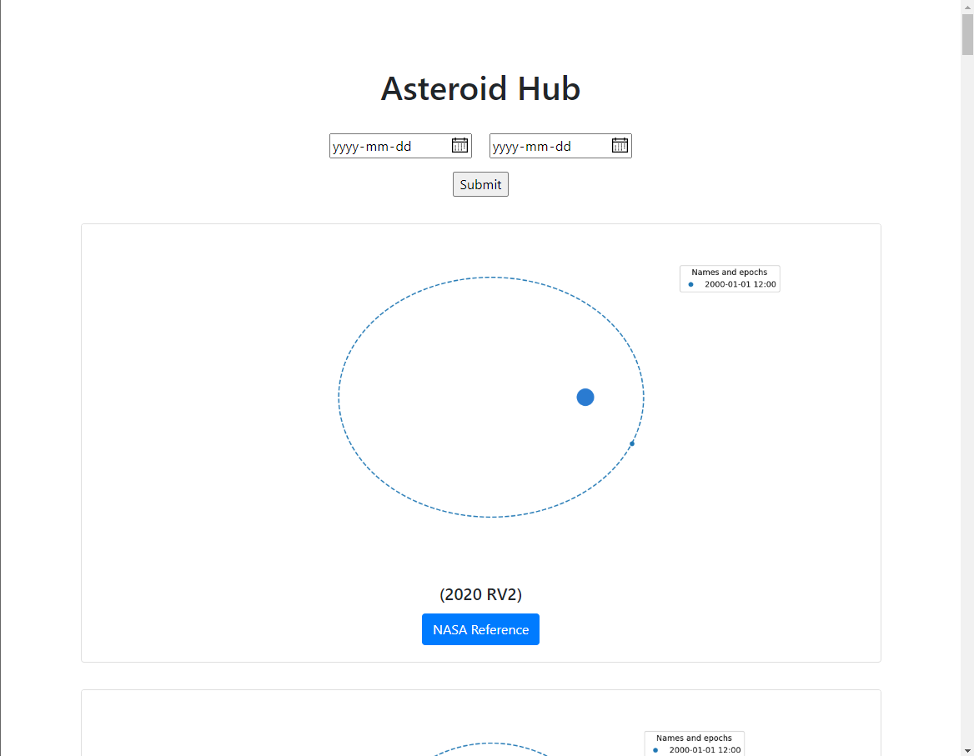
Asteroid Orbitals
Graphs Generated dynamically using matplotlib, then embedded into the website
Official Jet Propulsion Laboratory Reference available for each diagram
Plan: Add hazardous asteroids to the top of the page. Add the ability to sort data once presented

Slide 5
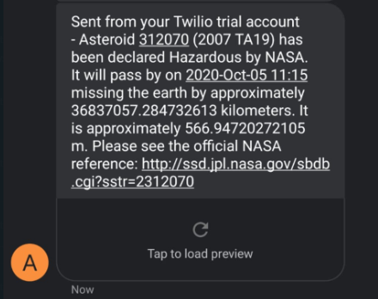
Hazardous Asteroid Subscription Service
Set up script on server to constantly check for new hazardous asteroids. Texts will be sent out as soon as a new asteroid is found
Plan: Create webpage to register new users. Add email list

Slide 6
Tech Stack
Python
Flask
Matplotlib
poliastro

